Slide 1


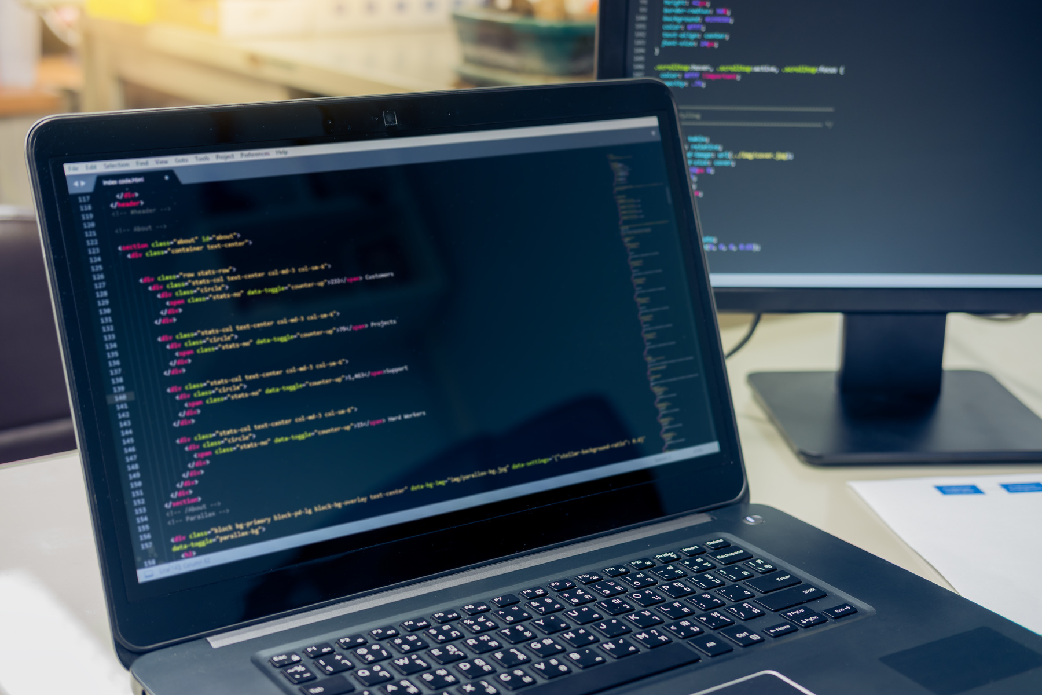


WEB CISC3003
CHUNG HOU SAM
DC325095
https://cisc3003team01.is-great.net

Slide 2
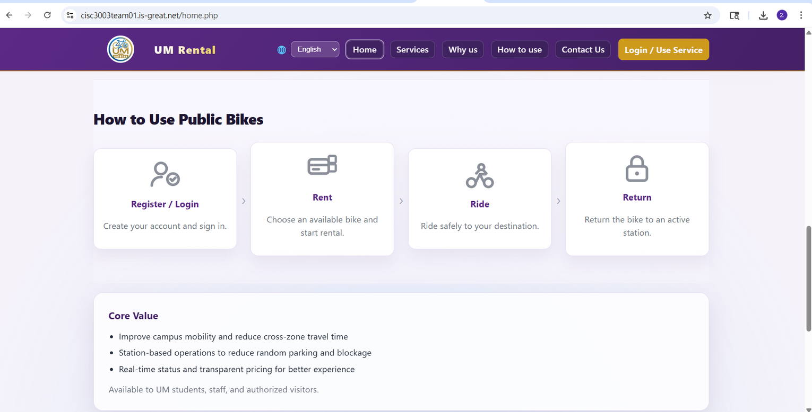
Users do not understand what the system does.
They do not know where to start.
They may not even reach the main functions.

Slide 3
Clear information expression As soon as users enter, they should know this is a campus bike rental system, not a general website.
Clear entry path From the homepage to login, the path should be short and easy to follow.
Consistent visual style Public pages should look like internal pages. This way, users feel they are using the same product after they log in.

Slide 4
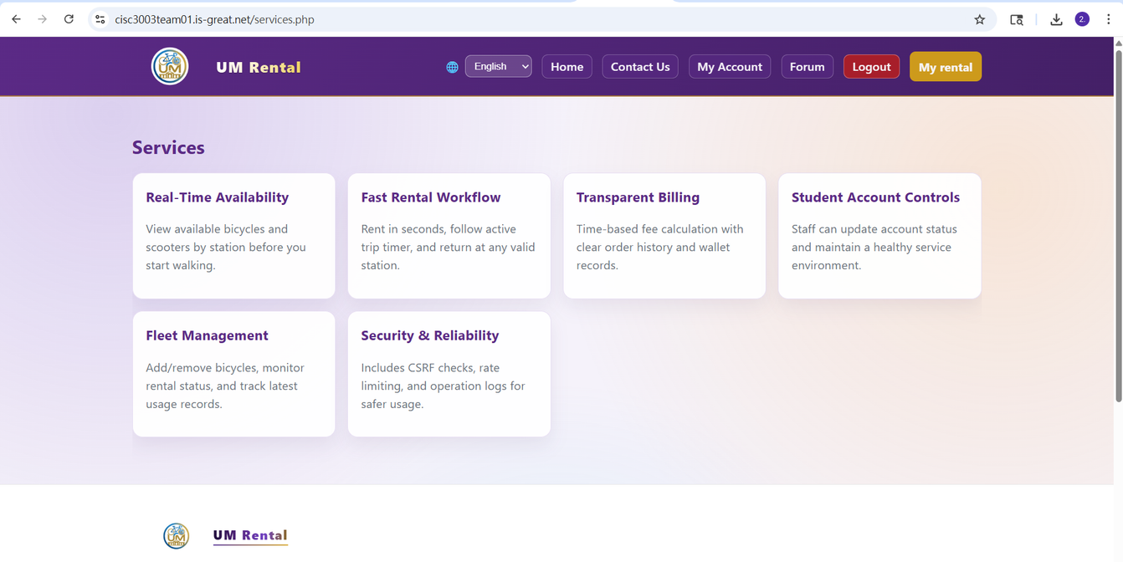
Immediate positioning Users should immediately know the purpose of the system. The homepage clearly explains the value: bicycle and e-scooter rentals for short trips on campus.

Slide 5
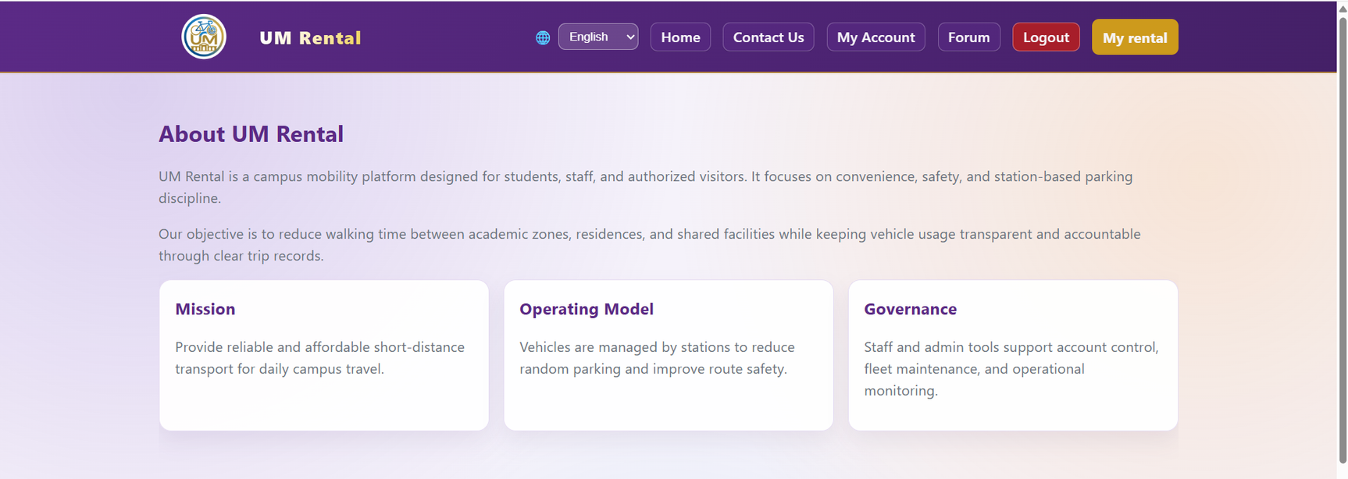
The navigation is designed to be simple. Users can move from the public page to login without getting confused.

Slide 6
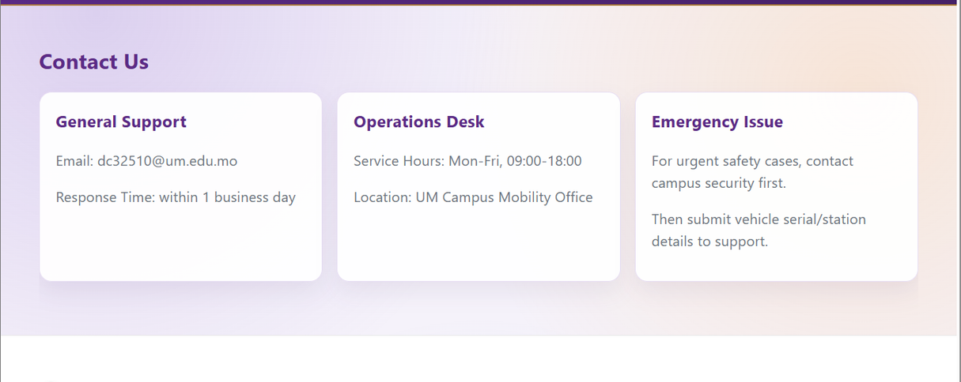
Public and internal pages should feel like one single product. If the styles are too different, users feel disconnected. So I used the same visual language and layout for both sides. I also organized the information by asking:

Slide 7
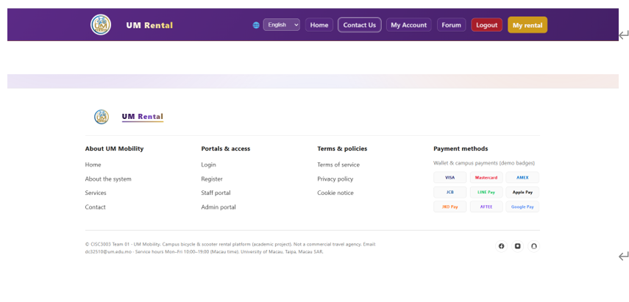
Public-facing pages (home.php, about.php, services.php, contact.php) Purpose: To answer what the system is and how to start.
Shared layout components (includes/public_header.php, includes/public_footer.php) Benefits:

Slide 8
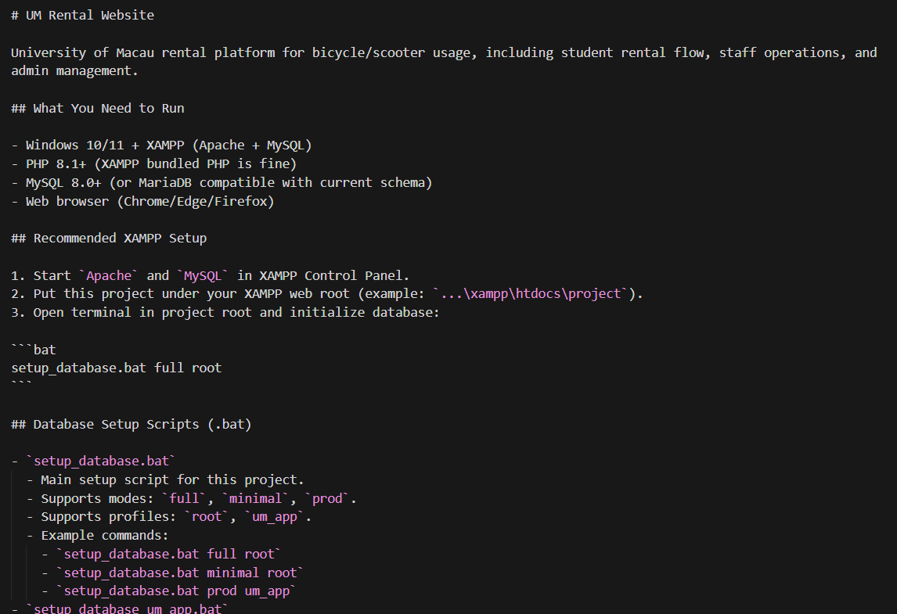
A common problem is when pages change, but the documentation stays old. We made sure to update the docs whenever we updated the pages. When paths or setup steps changed, the README and requirement files were updated too.

Slide 9
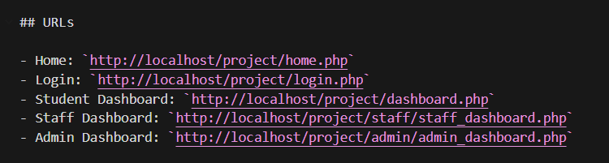
It is hard for new people to start.
Testing is unclear.
Deployment often has errors.

Slide 10
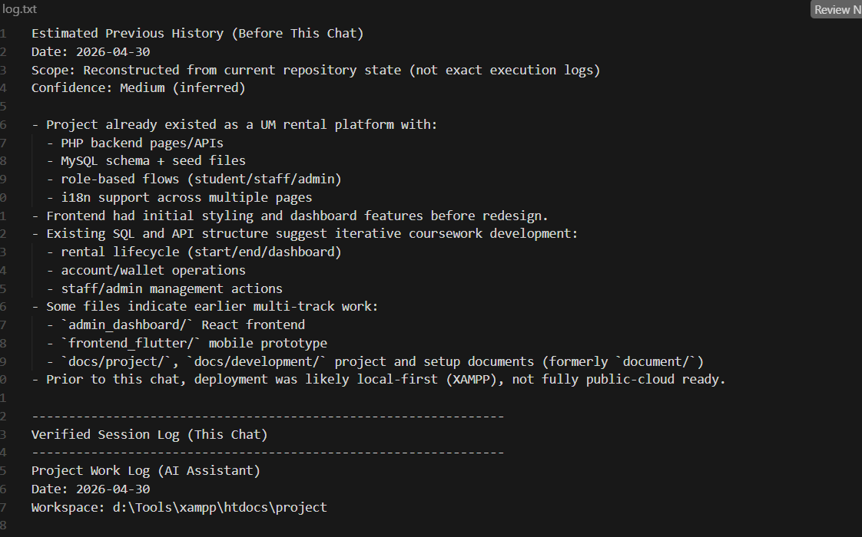
Better teamwork.
Stable testing for everyone.
Higher quality for the final submission.

Slide 11
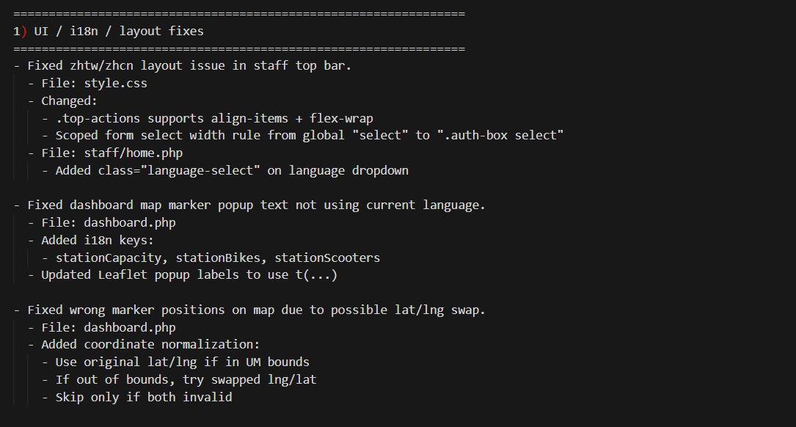

Slide 12
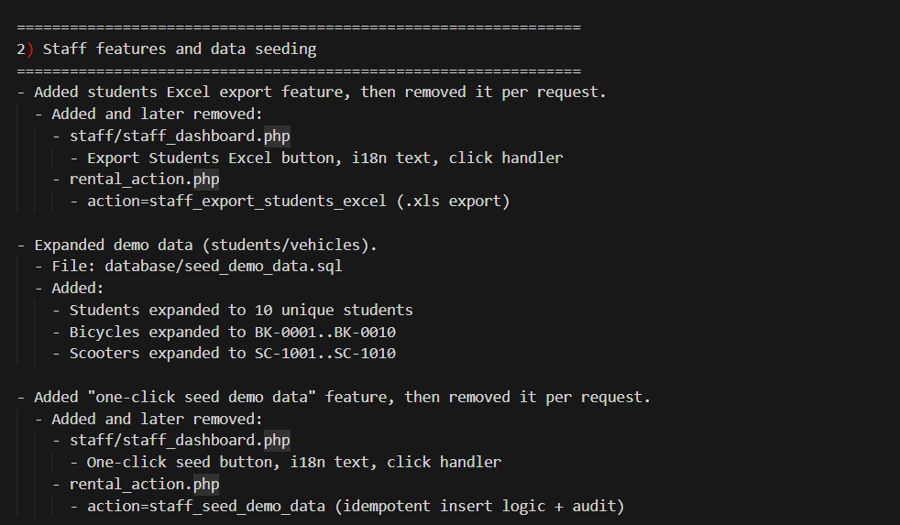

Slide 13
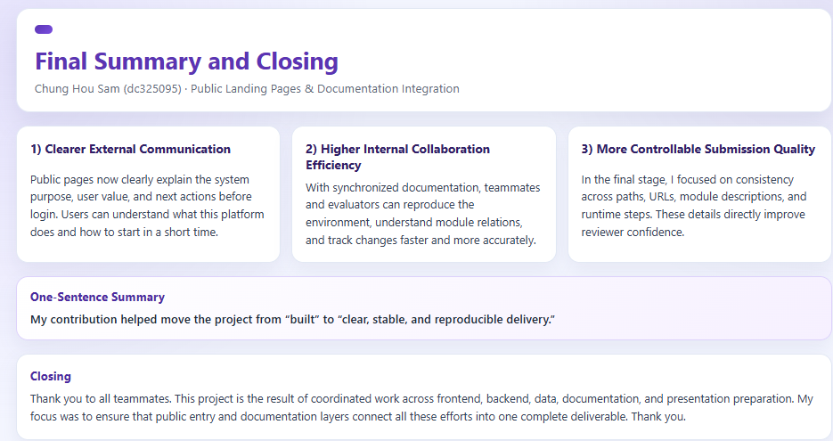

Slide 14
THANK YOU
www.reallygreatsite.com

